Slide 1

Online Safety & Digital Dangers
Presented ABC House

Slide 2
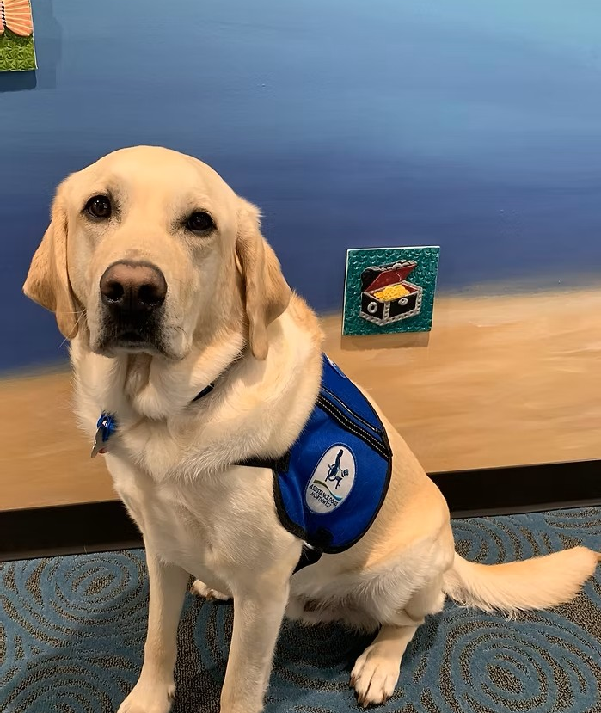

What is ABC House?
We help children stay safe
Medical exams for survivors of child abuse
Interviewing
Therapy
Community Education

Slide 3
Definitions:
Tech Abuse - Using technology (social media, the internet, texting, etc.) to get power and control over a person
Cyberbullying – Saying hurtful or mean things to someone using technology, even after they ask you to stop
Scamming – Using lies or manipulation to get money or information from a person
Blackmail – Threatening to release private information in order to control a person

Slide 4



3 SAFETY RULES
STOP
THINK
ACT

Slide 5

SCAMS:
Counterfeit Goods
Fake Scholarships
Data Collection

Slide 6
SCAMS:
STOP – Before you give away information, look at what’s in front of you

Slide 7
SCAMS:
THINK – Is it too good to be true? Do they need all the info they are asking for?

Slide 8
SCAMS:
ACT – If it seems suspicious: block, report, ignore

Slide 9

CYBERBULLYING
Hurtful words
Threats
Persistent
Anonymous
Common

Slide 10
CYBERBULLYING
STOP – Before you reply, take a minute to think

Slide 11
CYBERBULLYING
THINK – Who is the person bullying? Do I know them, or is it a stranger? What are they doing?

Slide 12
CYBERBULLYING
ACT – Block, report, ignore. Contact law enforcement if threats or blackmail is involved

Slide 13

INAPPROPRIATE POSTS
Online posts CAN & WILL affect your offline life
Employment, school, sports, etc.

Slide 14

INAPPROPRIATE POSTS
You could lose jobs, relationships, and school opportunities because of online posts…

Slide 15
INAPPROPRIATE POSTS
Nude photos of minors are ALWAYS ILLEGAL
No matter who sends or receives them

Slide 16
INAPPROPRIATE POSTS
Almost 50% of minors say they have received a nude photo from another minor

Slide 17
INAPPROPRIATE POSTS
Delete the photo
Tell the sender you don’t want photos like that
Tell an adult

Slide 18

ONLINE PREDATORS
Manipulation
Secrets
Blackmail
Abuse

Slide 19
ONLINE PREDATORS
Lying about identity
Building a relationship
Looking for vulnerabilities

Slide 20
ONLINE PREDATORS
Gifts (with strings attached)
Guilt-tripping
Inappropriate conversations

Slide 21
ONLINE PREDATORS
STOP – If a stranger tries to talk to you online, don’t reply

Slide 22
ONLINE PREDATORS
THINK – Who is this person? What do they want?

Slide 23
ONLINE PREDATORS
ACT – Block, report, ignore

Slide 24

FINAL THOUGHTS
Teach your children healthy tech habits
Tell them about digital dangers
No blame, no shame

Slide 25
FINAL THOUGHTS
Set rules early on
Be consistent
Check on what your child is doing online

Slide 26

FINAL THOUGHTS
ABCHouse.org
NetSmartz
National Center for Missing & Exploited Children

