Slide 1


Staying connected across the miles : Digital Technologies & Elder Care
DIVISION OF STUDENT AFFAIRS | FAMILY RESOURCE CENTER
Notes:
Must be in Slide Master mode to swap out photos.

Slide 2
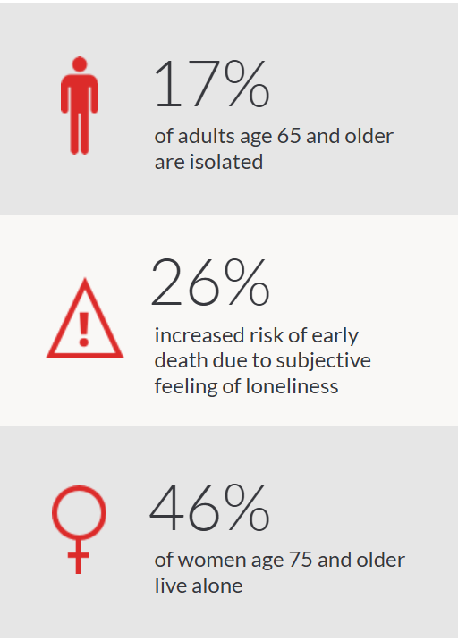
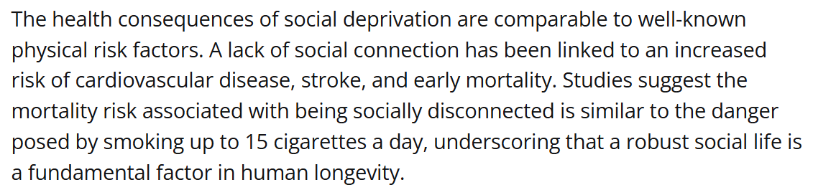

THE “WHY?”
About 28% of older adults live alone
Isolation and lack of social interaction have profound effects on mental and physical health (and longevity)
High blood pressure and heart disease
Anxiety and depression
Cognitive declines and memory loss disorders
Physical and social realities of older adulthood can contribute to isolation
Retirement, both end of formal work and financial realities
Physical aging: fatigue, chronic illness, mobility issues (driving)
Partner loss and families who relocate
Fear
Lack of opportunities (normalization of living alone/isolation)
Structural realities reinforce isolation and loneliness
Why Humans Are Wired to Be Social Animals - ScienceInsights

Slide 3

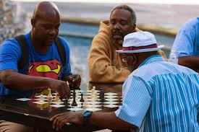

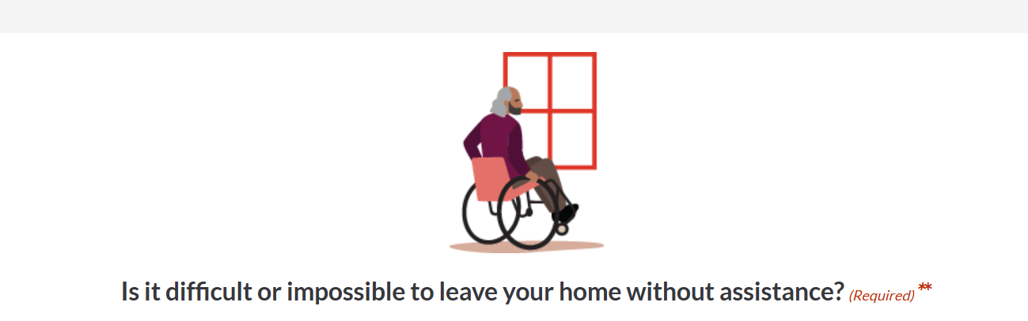
BEING AWARE OF THE RISKS & SIGNS
What’s the living situation?
Access to transportation?
Weekly activities?(a log, journal, or shared calendar)
Social, family, and care network?
Personality and mental health?
Talk with health or care providers
Connect2affect Assessment
https://connect2affect.org/assessment/

Slide 4
WHAT CAN CAREGIVERS OR LOVED ONES DO?
Schedule regular check-in times
Periodically assess risk factors or changes in routines, mood, or interaction level
Assist with searching for activities, registration, and logistics
Is “activity chaining” an option?
Medical appointment-lunch with friends-quilting group
Get curious! Ask questions about activities and engagement
What’s going well? What’s not?
Subscribe to local newsletters to keep up with events, programs, & resources
Go multimodal! Explore various digital, in-person, and hybrid options
Assess what your loved one can feasibly manage (more to share on that topic!)
Ensure your loved one understands fraud, scam, and other online engagement risks
Start small and empower active, informed decision making
Everyone is more likely to stick to something THEY choose and schedule
Set expectations realistically
Challenges and pivots will emerge
Flexibility is key! Some activity/interaction is better than none.
What are some examples of activities and social engagement you’ve observed or experienced?
Other insights or tips to share?

Slide 5

Kelly Fiori
Tell us a little about your day-in, day-out work and any observations you have about elders living on their own.
What are some of the key challenges older adults living on their own face in accessing communication technology or communicating with others more generally?
How can digital communications improve the socialization and overall well-being among older adults? Feel free to give examples.
What barriers do older adults face when learning to use devices and digital communication platforms? What do they find most frustrating or problematic?
What should caregivers who live apart from their elder loved ones do to ensure effective use of digital communications (devices/platforms)?
What are the main safety concerns for older adults who use devices?
Can you share a success story of an older adult using a device to communicate and engage? (someone taking classes, joining a group, etc)

Slide 6
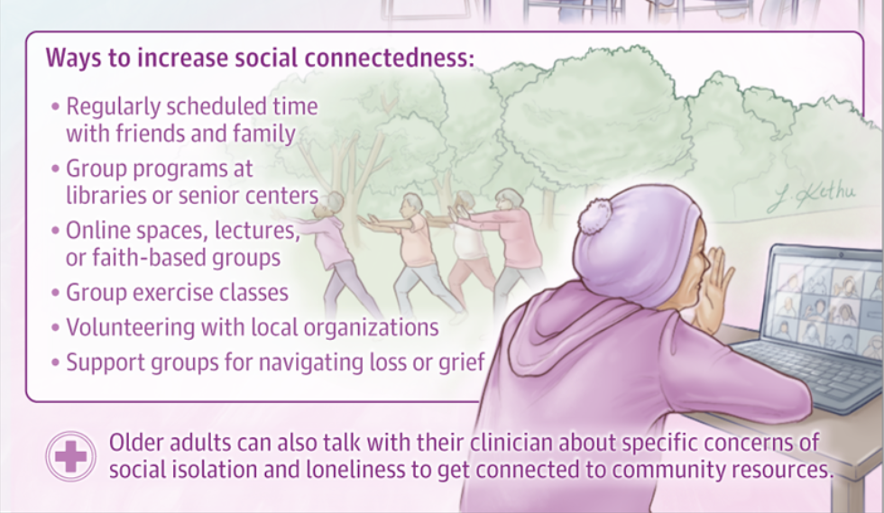
RESOURCES
AARP Resources
Help Older Adults Avoid Social Isolation Guide
Connect2Affect Program
8 Ways to Create and Build Social Connections (includes Social Isolation assessment)
Connect2Tools to Overcome Social Isolation
AARP Virtual Groups, Classes, Fitness, and More
Local Events and Online Virtual Events Near You (link goes to virtual programming)
Senior Center Locator Map
Tech Tips for Seniors
Claris Companion (tablet designed for older adults)

