Slide 1



Pre-Arrival Planning
and
Resource Guide
for
International Families

Slide 2

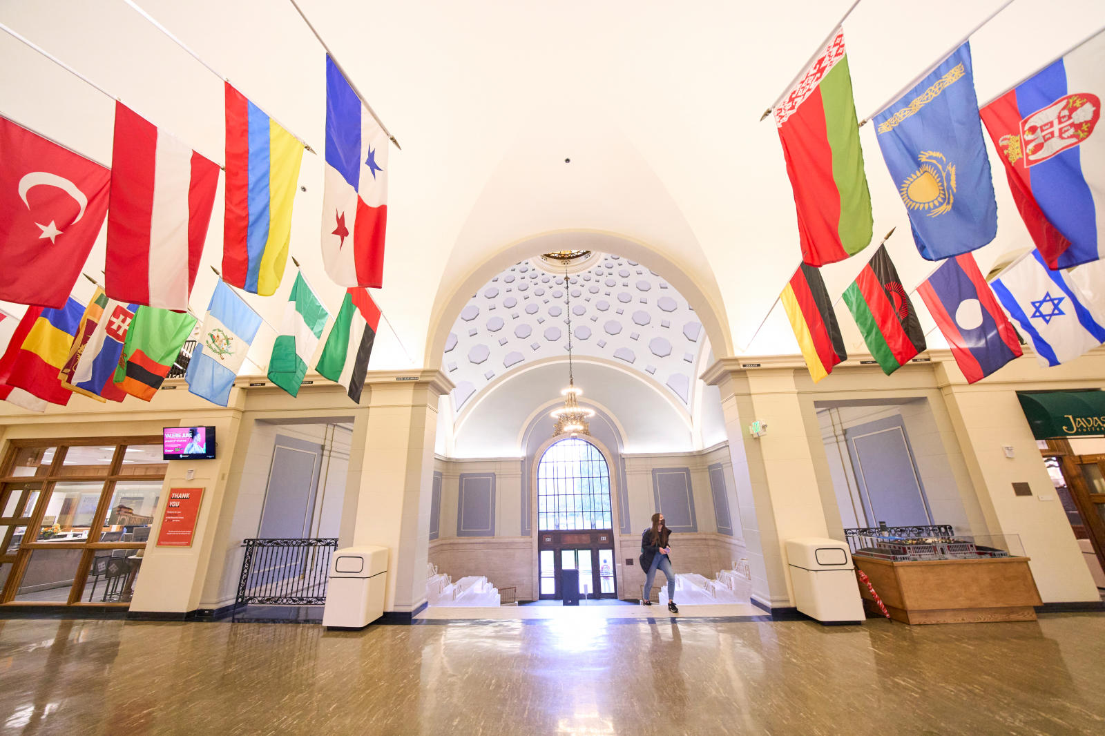
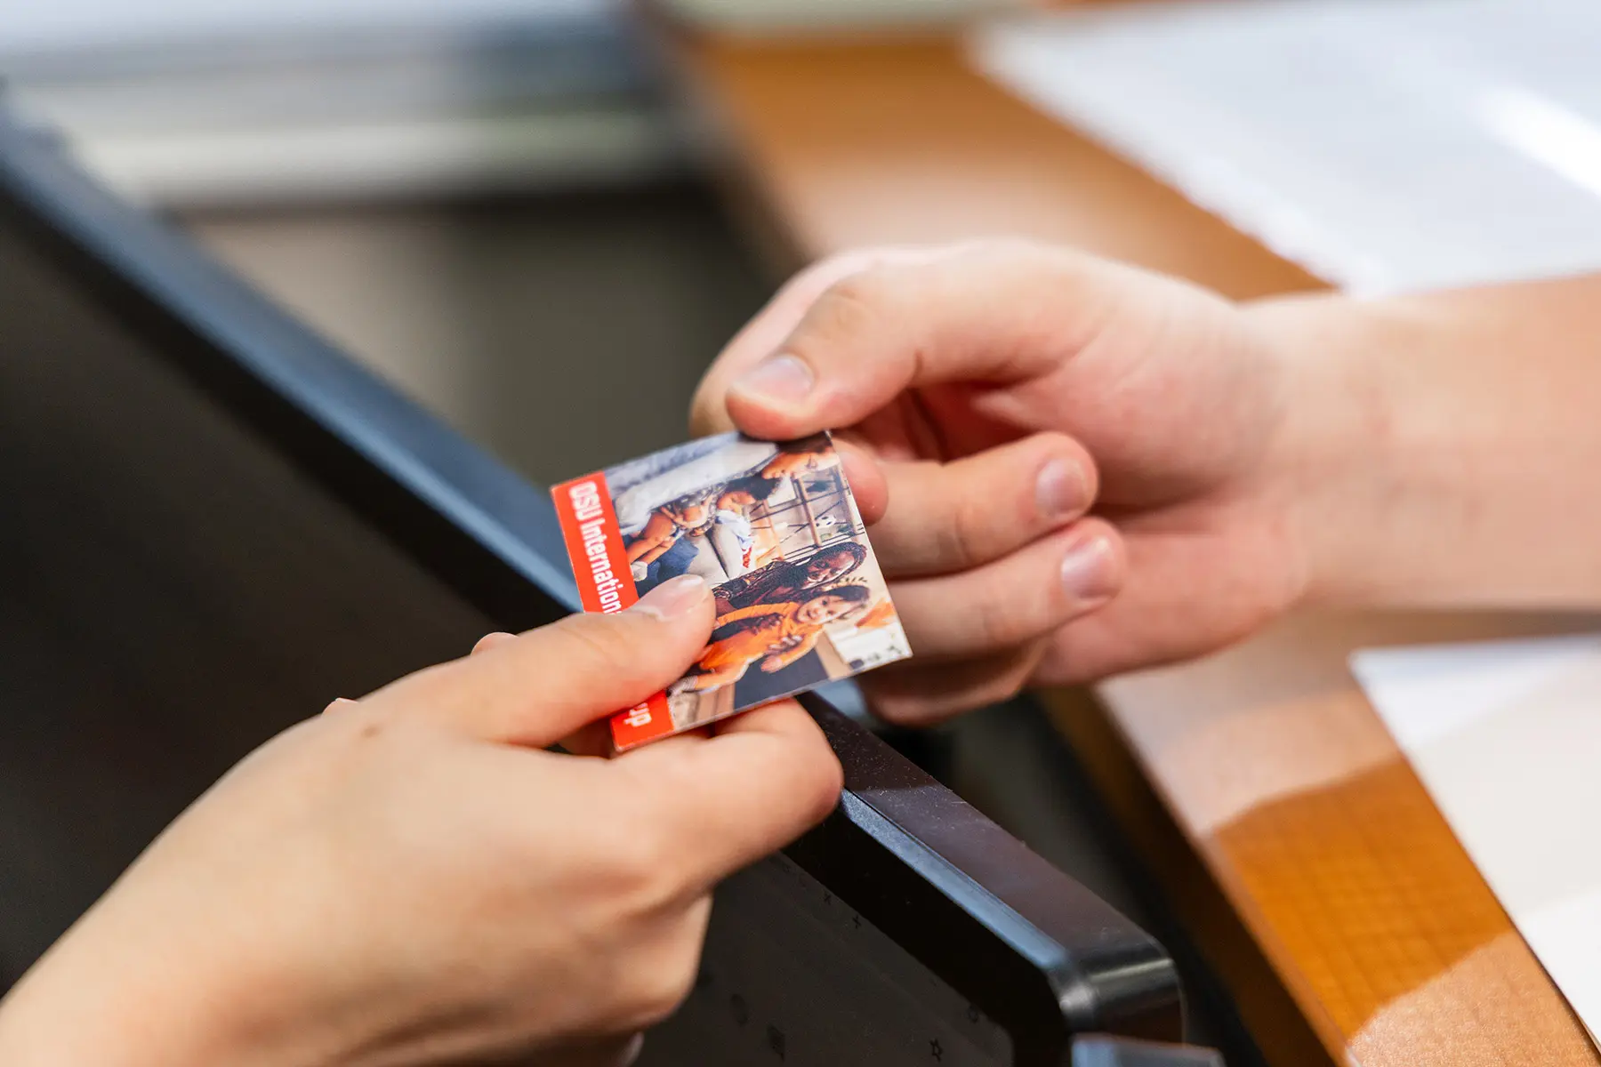
Welcome to Oregon State University!
Division of Student Affairs | Family Resource Center
familyresources.oregonstate.edu 541.737.4906
This guide contains information to assist you in planning for your time living in the United States with your family.
A word about its arrangement – you will see the guide contains both “OSU” and “Community” resources. These labels distinguish between resources and programs that are accessible to OSU-affiliated families (OSU Resources) and those that are open to anyone living in the community (Community Resources). Some resources, like the OSU Basic Needs Center’s Weekly Food Pantry and the International Moms Group, are open to both OSU affiliates and community members. It is important to check you/your family’s eligibility to access community resources, as eligibility criteria can change.
Community Resources are shared here as information only. OSU does not sponsor, nor specifically endorse these external entities. Please use the contact information provided to learn more about community programs and resources.
In addition to this information, you may find the following websites useful as you plan your move to the United States and get settled with your family:
Traveling with Dependents Module: https://pace.oregonstate.edu/content/ISPO/1m8c/presentation_html5.html
Bringing Your Spouse & Dependents: https://internationalservices.oregonstate.edu/ieev/getting-here/ieev-dependents
Bringing Dependents & Inviting Family: https://internationalservices.oregonstate.edu/students/getting-here/bringing-dependents-and-inviting-family
INTO OSU: Pregnancy & Child Care: https://intoosu.oregonstate.edu/pregnancy-and-childcare
Family Resource Center: Tips & Information for International Families: https://familyresources.oregonstate.edu/information-and-tips-international-families

Slide 3



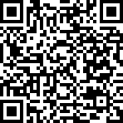

OSU RESOURCES
Housing
Health Care
Division of Student Affairs | Family Resource Center
familyresources.oregonstate.edu 541.737.4906
Orchard Court Family Housing:
Offers 1, 2, and 3-bedroom units to OSU students with dependents. Units are unfurnished but include a refrigerator and stove. Amenities include onsite laundry facility, a community garden, a playground, and a community center. The complex sits on the western edge of campus and is served by the Beaver Bus. This housing option has a waitlist, so it is important to apply as soon as possible. International scholars and others may learn about housing options at OSU HERE.
Website: https://beav.es/x46
Contact: 541.737.4771 or housing@oregonstate.edu
Unlike some other countries, the US does not have a national health care system. At OSU, benefits-eligible employees and students can access primary health care and health insurance. For international students, OSU Student Health Services (SHS) offers primary health care at several locations on campus. SHS does not provide pediatric care for children or care for other dependents (see Community Resources in this guide for family health care options). Health insurance coverage is required for you and your family while living in the US. Enrollment procedures and costs vary according to the plan you select. You can learn more about insurance coverage requirements and how to add a dependent to your plan HERE. Benefits-eligible international employees and other non-student affiliates can learn about insurance coverage HERE.
For more information and tips, use the link or QR below:
https://beav.es/xJ3
Care & Education
Care & Education, continued
OSU Family Resource Center Campus-Based Early Care & Education:
OSU has several full and part-time child care options, ranging from age 6 weeks to 10 years. Full-time centers often have waitlists, so it is important to apply as soon as possible. Explore the link below to learn about Azalea ECE Center (Corvallis Campus) and Little Beavs ECE Center (OSU Cascades).
Website: https://familyresources.oregonstate.edu/frc-ece
Contact: 541.737-4906 or familyresources@oregonstate.edu
Our Little Village: Offers short-term, drop-in and reservable care for children ages 5 months to 10 years. No cost to current OSU students who pay the student incidental fee. Employees pay a fee for care. Locations: OLV Dixon and OLV Milne
Website: https://familyresources.oregonstate.edu/OLV Contact: 541-737-5515 or ourlittlevillage@oregonstate.edu
Beaver Beginnings Child Care Center: Located on the Covallis campus, this center offers full and part-time care options for children ages 6 weeks through preschool.
Website: https://www.kindercare.com/our-centers/corvallis/or/301417
Contact: 541.737.4641 or OSUBeaverBeginnings@kindercare.com
OSU Child Development Center: This on-campus center provides part-time weekly care during the academic year for children ages 3 and 4. Children must be at least 3 and no older than 4 by September 1st of the year they enroll.
Website: https://health.oregonstate.edu/child-development-center
Contact: 541.737-8261 or osu.cdc@oregonstate.edu
KidSpirit: Offers on-campus programs for children and youth ages 2 to 18, including arts, cooking, gymnastics, science, and sports. KidSpirit also offers summer camps and no-school-day camps.
Website: https://kidspirit.oregonstate.edu/
Contact: 541.737.5437 or kidspirit@oregonstate.edu

Slide 4

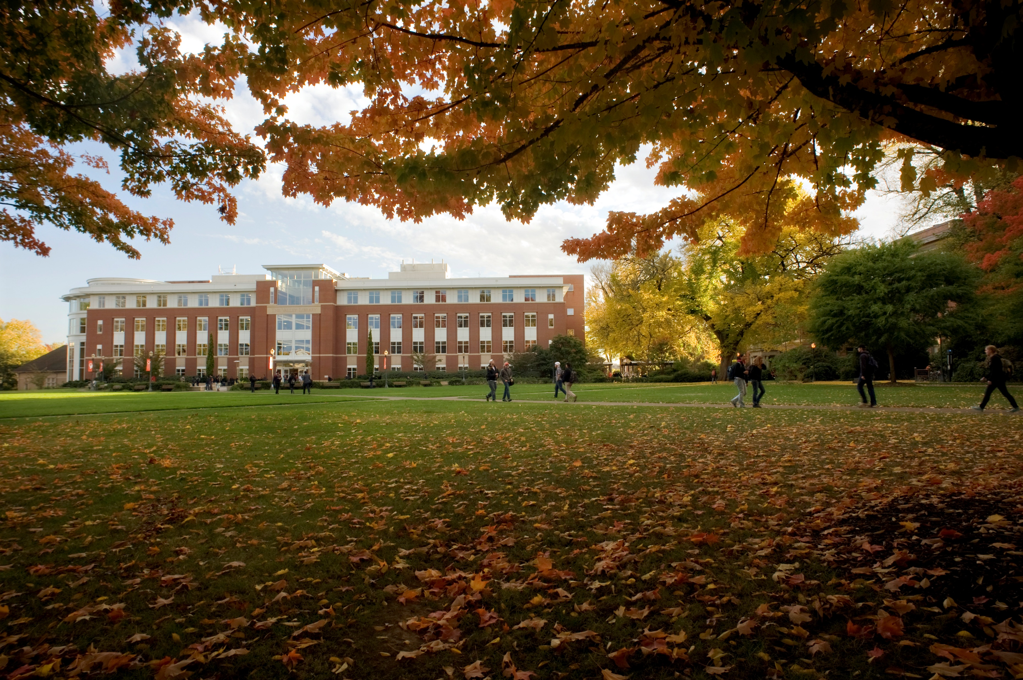


OSU RESOURCES
Food & Basic Needs
Division of Student Affairs | Family Resource Center
familyresources.oregonstate.edu 541.737.4906
Basic Needs Center:
Offers food resources, peer support, and a community space for all. Supports include weekly food pantry for income-eligible students and community members, weekly no-cost meals, cooking classes, fun events, and referrals to other basic needs resources. The center also maintains a textbook lending program, a kitchen, and free, onsite laundry.
Website: https://basicneeds.oregonstate.edu/
Contact: 541.737.3747 or bnc@oregonstate.edu
Family Resource Center:
All OSU-affiliated community members can utilize FRC programs and supports. Resources include: child care financial assistance, children’s clothing exchange, limited supply of diapers and wipes, lactation rooms and other lactation supports, family spaces on campus, and more.
Website: https://familyresources.oregonstate.edu/resources-and-services
Contact: 541-737.4906 or familyresources@oregonstate.edu
Need to access a lactation room on campus?
Please see the list of locations here: https://familyresources.oregonstate.edu/lactation-rooms-supports
Email
familyresources@
oregonstate.edu or
call 541.737.4906 for a personalized access code.
For more information and tips, use the link or QR below:
https://beav.es/xJ3
English Language Learning Opportunities
OSU Writing Center: In-person and virtual consultations to assist students with any type of writing assignment.
Website: https://writingcenter.oregonstate.edu/
Contact: 541-737-5640 or writing.center@oregonstate.edu
INTO Conversant Program: Term-based interactive program to support English language learning. Meet new people and learn about US culture. Offered to INTO students. Website: https://beav.es/xJ2 Contact: 541-737-2464 or INTOOSU@oregonstate.edu
INTO Learning Center: Students enrolled in INTO programs access no-cost tutoring, English-language books, study spaces, and other resources to practice listening,
speaking, and writing skills. Website: https://intoosu.oregonstate.edu/learning-center Contact: INTOOSU.LearningCenter@oregonstate.edu
Finances & Budgeting
CAFE
Offers one-stop financial wellness center, providing free services. Tax filing assistance. Budgeting tips. Individual consultations and more.
Website: https://beav.es/xJB Contact: 541.203.0542 or cafe@oregonstate.edu

Slide 5


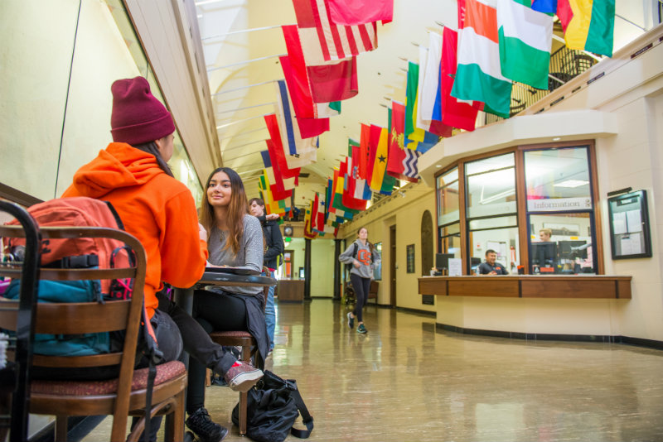
OSU RESOURCES
Belonging & Connection
Division of Student Affairs | Family Resource Center
familyresources.oregonstate.edu 541.737.4906
Crossroads International School: Connects international students, faculty & scholars, and their family members with local volunteers for friendship and language education, including a conversation program for women, social gatherings, and short-term homestays.
Website: https://internationalservices.oregonstate.edu/crossroads/conversation-school
Contact: 541-737-6310 or crossroadsosu@gmail.com
INTO Conversant Program: Term-based interactive program to support English language learning. Meet new people and learn about US culture. Offered to INTO students.
Contact: 541-737-2464 or INTOOSU@oregonstate.edu
International Moms Group: Weekly in-person meetings Fall, Winter, and Spring terms with some periodic gatherings during Summer term. Additional special events and cultural celebrations happen throughout the year. Opportunities to meet other OSU and community-based international moms and their families.
Website: https://familyresources.oregonstate.edu/internationalmoms
Contact: internationalmomsgroup@oregonstate.edu
Family Resource Center Connection Series: Offers employees, students, and visiting scholars opportunities to connect with other parents and caregivers to discuss parenting, child development, family wellness, and other topics. Monthly lunchtime meetings with food provided.
Contact: Cari Maes, 541-737-4906 or familyresources@oregonstate.edu
OSU Clubs & Organizations: OSU offers over 400 interest-based clubs with multiple ways to get involved and meet other students. Search the clubs database based on your interests for more information.
Contact: 541-737-9857 or student.orgs@oregonstate.edu
Student Experience & Engagement: offers opportunities that can help you find community and connection, connect with your interests, build skills for employability, challenge your heart and mind, amplify your strengths, help you connect to purpose, lift your spirit, and support you living your best life. Events and gatherings happen throughout the academic year.
Contact: 541-737-6339 or student.experiences@oregonstate.edu
Family-Friendly Spaces (OSU Campus): The Family Resource Center offers locations on campus where children and families can enjoy time together or meet up with others. Click HERE for an interactive map of the Corvallis campus. Website: https://familyresources.oregonstate.edu/family-spaces Contact: 541.737.4906 or familyresources@oregonstate.edu
Need information about
OSU Transportation options?
Use the link/QR below for more information or visit OSU’s Transportation Services site.
https://transportation.oregonstate.edu/new-to-OSU
Additional Opportunities
For more information and tips, use the link or QR below:
https://beav.es/xJ3
OSU’s Office of International Services offers the following programs. Visit the links for more information:
Global Buddies Program
https://internationalservices.oregonstate.edu/students/exploring-here/global-buddies-program
International Friendship Program
https://internationalservices.oregonstate.edu/international-friendship-program
See more opportunities here:
https://internationalservices.oregonstate.edu/students/exploring-here

Slide 6

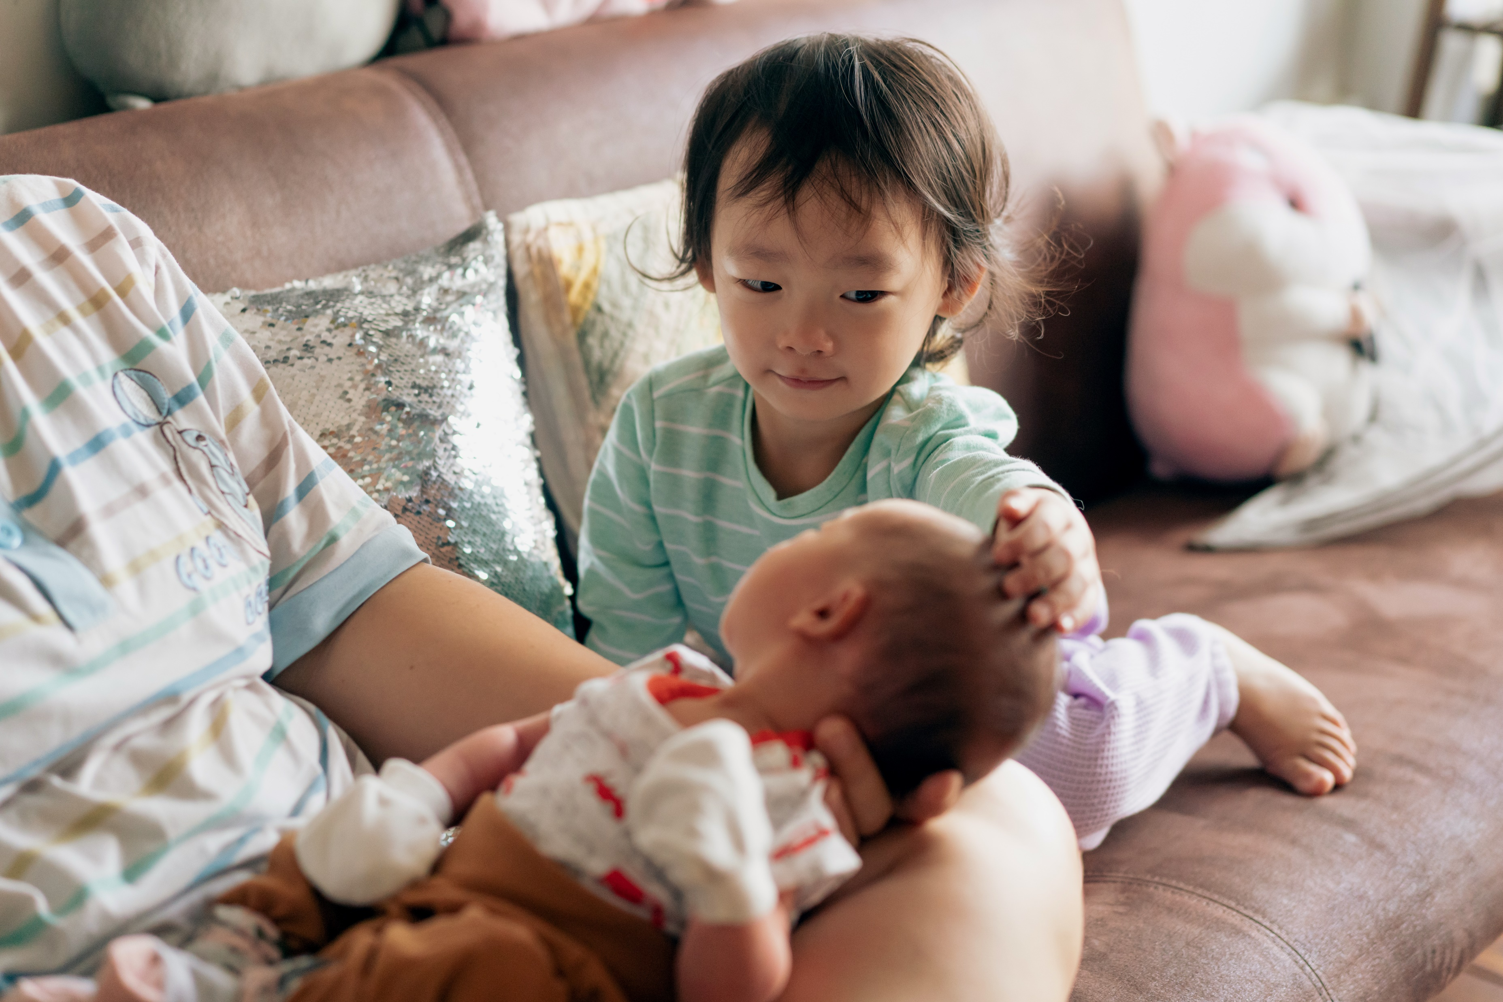
COMMUNITY RESOURCES
Division of Student Affairs | Family Resource Center
familyresources.oregonstate.edu 541.737.4906
Housing
Transportation
Corvallis Off-Campus Living Guide & Resources
INTO OSU provides some basic information about renting in the local community. Access the guide and links to other local resources related to housing HERE. This link also provides a list of apartment options and other short-and long-term housing options in Corvallis.
City of Corvallis-Housing & Neighborhood Services: Offers information on affordable housing options in and around OSU’s main campus in Corvallis. Click here for information related to affordable housing near OSU’s Cascades Campus.
Corvallis Transit System: Local bus service. Free for all users. Accommodations for riders with disabilities and options to transport bikes and strollers.
Website: https://www.corvallisoregon.gov/cts
Oregon Driver & Motor Vehicle Services: Information about obtaining a driver’s license or ID card, vehicle registration and titling, and driving rules.
Website: https://www.oregon.gov/ODOT/DMV/pages/index.aspx
Airport Shuttles: Groome Transportation and the Flix Bus provide ground transportation to area airports. These services must be booked in advance.
Websites: https://groometransportation.com/ and https://www.flixbus.com/
*Uber and Lyft operate in the Corvallis area, including between the campus area and the Eugene/Portland airports.
Care & Education
Oregon, like many states in the US, has a scarcity of child care options, particularly for infants. Most child care centers in Oregon will have waitlists. It is best to explore child care options as early as possible and come up with several potential plans. Corvallis has center-based, group care and in-home care providers who private citizens who provide child care in their homes. They may offer both full-and part-time options. Child care begins around age 6 weeks for most providers and continues through pre-school age, around age 4 to 5. Children age 5 as of September 1 are eligible to enroll in public school. Explore the community-based resources for finding child care below:
Family Connections @ Linn Benton Community College: Provides personalized referrals for child care. They also provide a checklist for parents to help parents ask the right questions and get key information as they search for child care options. See the checklist here: https://beav.es/xUe
Website: https://www.linnbenton.edu/community/family-resources/child-care.php
Contact: 541.917.4899 or connect@linnbenton.edu
Find Child Care Oregon or 211 Info: An online database of child care providers across Oregon. Users can search by location and filter for the preferred type of care. 211 Info also offer child care refer options via telephone by dialing 2-1-1 or 1-866-698-6155
Website: https://findchildcareoregon.org/
Corvallis School District: Public school runs from early September to mid-June for ages 5 (by Sept 1) to 18.
Website: https://www.csd509j.net/ Contact: 541.75705811 Other Districts: Philomath School District 541.929.3169 Albany School District 541.967.4901
For more information and tips, use the link or QR below:
https://beav.es/xJ3

Slide 7


COMMUNITY RESOURCES
Division of Student Affairs | Family Resource Center
familyresources.oregonstate.edu 541.737.4906
Care & Education, continued
Boys & Girls Club Corvallis: Provides care, sports, and enrichment for children ages kindergarten and above. Offers afterschool and non-school-day care. Scholarships available.
Website: https://www.bgccorvallis.org/programs/ Contact: 541.757.1909
Mid-Willamette Valley YMCA: Located in Albany, OR. Offers child care, sports, and enrichment activities for children preschool age and above. Scholarships available.
Website: https://www.ymcaalbany.org/ Contact: 541.926.4488
Other resources:
Parent Guide for English Learners: Developed by the Corvallis School District to help parents understand the processes and supports in place for students who are English-Language learners.
Family Advocacy & Support: School-based family advocates assist with resource navigation, assist students with disabilities, provide multilingual support to families and students, and more. Learn more here: Corvallis School District Albany School District Philomath School District
Food & Basic Needs
Note: It is important to verify eligibility requirements for the following resources. Non-profit organizations often have fluctuating funding levels that affect their capacity to provide services and resources to the community.
Local Food Banks & Pantries and Meal Sites: Sites that provide no-cost food resources, including fresh foods and meals, for qualifying families. Options in Benton and Linn Counties. Website: https://communityservices.us/linn-benton-food-share/ Contact: 541.754.9511
Furniture Share: Provides new and used donated furniture and household items to families at or below the federal poverty level. School district family advocates and Benton County Health Navigators can connect families with this resource. Website: https://furnitureshare.org/ Contact: 541.754.9511
Corvallis Community Center: Free community resources, including legal aid, technology assistance, free classes, and family events.
Website: https://www.corvallisoregon.gov/c3 Contact: 541.766.6959
OSU Surplus Store: Sells used items to the OSU community and general public, including bicycles, electronics, furniture, office supplies, and more.
Website: https://surplus.oregonstate.edu/public-sales/osused-store Contact: 541.737.7347
For more information and tips, use the link or QR below:
https://beav.es/xJ3

Slide 8


COMMUNITY RESOURCES
Division of Student Affairs | Family Resource Center
familyresources.oregonstate.edu 541.737.4906
Health Care
Benton County Health Clinics & Health Navigators: Community-based health centers with specialists who can help families access health care, navigate care options, and access other health and wellness programs,.
Website: https://clinics.bentoncountyor.gov/
Contact: 541-766-6835
Samaritan Health: Offers a range of health care and medical services for the whole family, including OB/GYN, pediatrics, and mental/behavioral health. Corvallis’ main Emergency Room is located at the Good Samaritan Regional Medical Center.
Website: https://samhealth.org/ Contact: 1.800.863.5241
Corvallis Clinic: Provides comprehensive health and medical services for the whole family., including mental health, pediatrics, obstetrics/gynecology, and more. Main location in Corvallis has a walk-in immediate care center.
Website: https://www.corvallisclinic.com/ Contact: 541.754.1150
For more information and tips, use the link or QR below:
https://beav.es/xJ3
Health Care, continued
Samaritan Health/Good Samaritan Regional Medical Center: This is the Corvallis community’s largest health care facility, including surgical center, pediatrics, cancer center, and an emergency department.
Website: https://samhealth.org/
Contact: 1-800-863-5241
Urgent Care: Samaritan Health and the Corvallis Clinic both offer urgent care clinics.
Call 9-1-1 for all major health emergencies. Corvallis’ main Emergency Center is located at Good Samaritan Regional Medical Center. Open 24 hours.
Community Doula Program: Provides culturally-matched pre-natal and birthing support for expecting mothers and babies. Accepts Pacific Source, OHP, and other health insurance plans. Offers referrals for lactation support and other community-based resources.
Website: https://www.communitydoulaprogram.org/
Contact: admin@communitydoulaprogram.org

Slide 9



COMMUNITY RESOURCES
Division of Student Affairs | Family Resource Center
familyresources.oregonstate.edu 541.737.4906
Belonging & Connection
Corvallis Multicultural Literacy Center: Classes and workshops, as well as cultural events for the whole family.
Corvallis Community Center: Events, adult and youth programs, free resources and supports. Fun classes and workshops.
Website: https://www.corvallisoregon.gov/c3 Contact: 541.766.6959
OSU International Moms Group: Weekly in-person meetings Fall, Winter, and Spring terms with some periodic gatherings during Summer term. Additional special events and cultural celebrations happen throughout the year. Opportunities to meet other OSU and community-based international moms and their families.
Website: https://familyresources.oregonstate.edu/internationalmoms Contact: 541.737.4906
Corvallis Parks & Recreation: Child and youth programs, including sports, summer camps, and other enrichment classes for the whole family. Special events throughout the year. Scholarships available. Website: https://www.corvallisoregon.gov/parksrec
Corvallis Public Library: Programs and services for the whole family, including tech assistance, employment assistance, arts/crafts events, and children’s literacy programs. Website: https://cbcpubliclibrary.net/
English Language Learning Opportunities
For more information and tips, use the link or QR below:
https://beav.es/xJ3
Crossroads International School: Connects international students, faculty & scholars, and their family members with local volunteers for friendship and language education, including a conversation program for women, social gatherings, and short-term homestays.
Website: https://internationalservices.oregonstate.edu/crossroads/conversation-school Contact: 541-737-6310 or crossroadsosu@gmail.com
Corvallis Multicultural Literacy Center: Offers multiple English classes for various levels of English proficiency. Other classes, workshops, resources, and family events, too.
Website: https://cmlcenter.org/
Contact: info@cmlcenter.org
Linn Benton Community College-English Language Acquisition: Various options for learning English in a traditional classroom. Credit-bearing and non-credited course options available.
Website: https://www.linnbenton.edu/community/alt-paths/ela.php
Contact: 541.917.4710 or ela@linnbenton.edu

