Slide 1
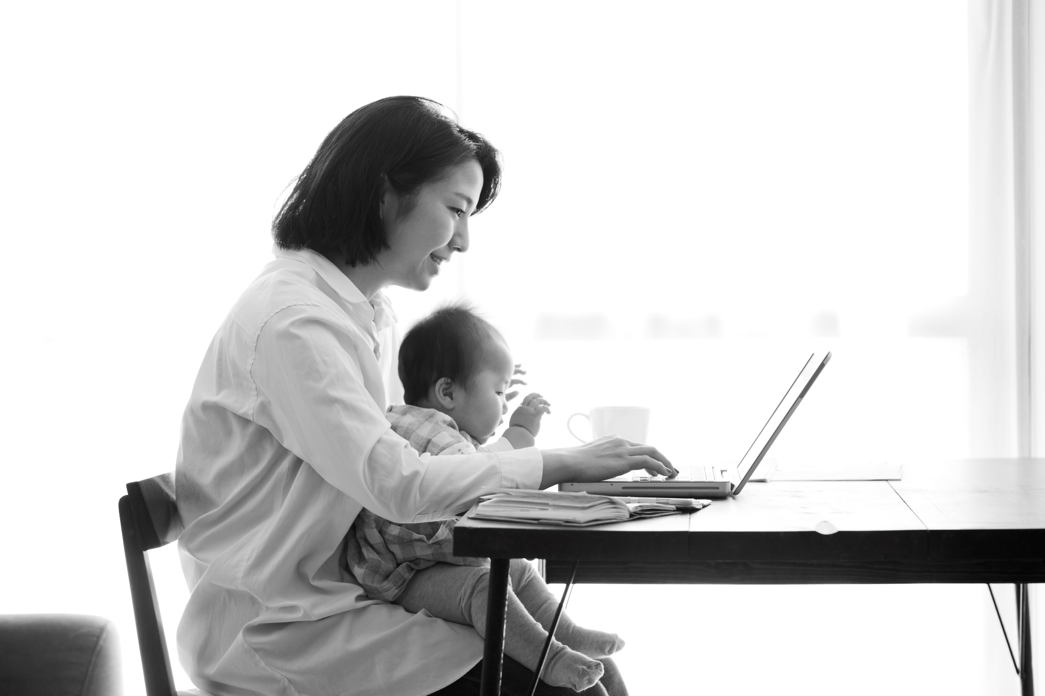

Division of Student Affairs | Family Resource Center
BEAVER MOMS CONNECTIONS
12-1:00pm MU 221/BOARD RM
Join other self-identified OSU moms and anyone interested in the topic of motherhood to talk about parenting, work and everything in between.
This is a time for informal connection and conversation, so drop by as your schedule allows. No sign-up required. All are welcome! Lunch provided.
Winter Term Dates
JANUARY 6
FEBRUARY 3
MARCH 3
For accommodations due to disability,
please contact cari.maes@oregonstate.edu or 541-737-4906

