Slide 1

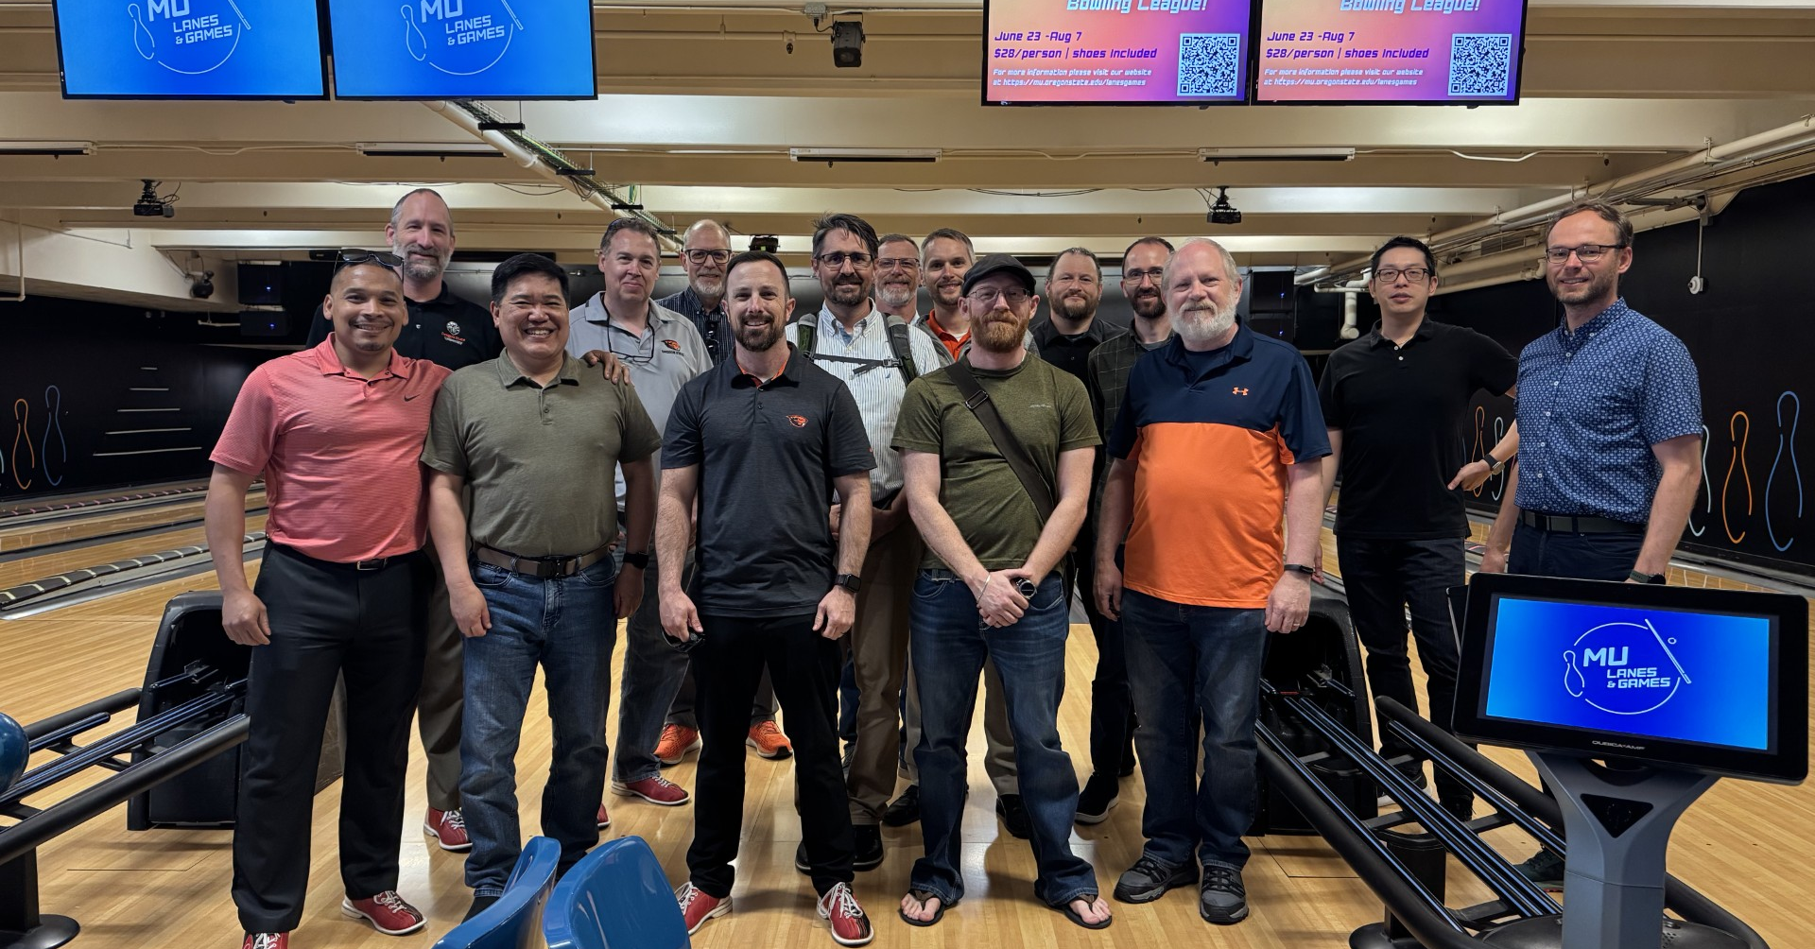

Division of Student Affairs: Family Resource Center
BEAVER DADS CONNECTIONS
THURSDAYS, 12-1:30pm MU 212/MLK ROOM
Join other self-identified OSU dads, dads-to-be and others interested in fatherhood to talk about parenting, work, and everything in between. This is a time for informal connection and conversation, so drop by as your schedule allows. No sign-up required. All are welcome! Lunch provided.
Facilitated by Tarron Anderson (UHR).
WINTER TERM DATES
JANUARY 8
FEBRUARY 12
MARCH 12
For accommodations due to disability,
please contact cari.maes@oregonstate.edu or 541-737-4906

