Slide 1

Medicare 2026 changes
November 2025
Sponsored by Lincoln-Linn-Benton SHIBA
Presenter: Denise Lach

Slide 2
Brought to you by ...
Educate
Advocate
Refer
Federally sponsored non-profit program
Free classes and individual appointments
Certified SHIBA volunteers
1-541-812-0849 for appointments

Slide 3
SHIBA Medicare Guide
Available online:
https://shiba.oregon.gov/Pages/index.aspx. Then click on 2026 Medicare Guide

Slide 4
Health Insurance Choices
Parts A and B (Original Medicare)
Medigap
Plans
Advantage Plans (Part C)
Can include Part D
Stand Alone
Prescription
Plan (Part D)
Health Maintenance Plans (HMOs)
Preferred Provider Plans (PPOs)
Financial penalties may apply for failure to sign up for Parts A, B or Part D (Rx drug plan) after age 65 unless still insured by employer

Slide 5
Changes in 2026
Part B premium increased to $206/month
Part B deductible raised to $288 /year
Premiums and Medical co-pays rising with all Medicare plans.
Extra benefits from Advantage plans being reduced or eliminated and providers opting out of Advantage plans. Example: Samaritan PPO and HMO plans no longer offered in Benton County

Slide 6
More Changes in 2026
Part D drug deductible capped at $615/ year. ​
Part D drug deductible capped at $615/ year.
Advantage plans and stand-alone drug plans raising deductible close to maximum and some applying co-pays to tier 1 and 2 generics.
General rule: low premium plan drug plans with high deductible are more cost effective than a zero deductible plan with high premium.
Maximum out of pocket for covered drugs capped at $2,100 per year (plus premium) by inflation reduction act. This is great for people with high cost medications. but is a major driver to increased medical and premium costs.. ​
Drug co-pays rising even for tier 1 and 2 drugs (% vs dollar amount)​
General rule: low premium plan drug plans with high deductible are more cost effective than a zero deductible plan with high premium.​
​
Maximum out of pocket for covered drugs capped at $2,100 per year (plus premium) by inflation reduction act. This is great for people with high cost medications. but is a major driver to increased medical and premium costs.

Slide 7

Trade-offs in Choosing A Drug Plan
Choosing a plan is a balancing act of monthly premium, deductible, coverage of drugs, & pharmacy network.
Ensure that your plan includes all your current medications at lowest acceptable co-pay at your favorite pharmacy (standard or preferred).
Not signing up because you take no medications is a bad choice: Penalty of 1% per month if delay 6 months after starting part B or 60 days after leaving employer plan. months after starting Part B or leaving

Slide 8
Drug Formularies: Review Every Year
Samaritan: lowest co-pay with insulin lispro, Jardiance, and hydrochlorothiazide, losartan
Other advantage plans and Part D plans prefer Humalog or Novolog, Farxiga (not generic), and combination hydrochlorothiazide/losartan.
Deductible period: Drug price =$619.71. You pay $615. Plan pays $0.
After deductible: You pay $47. Plan pays $468.
Your payment counts toward the $2,100 out of pocket maximum.
“Trump Rx”: 50% discount off price of brand name drug. Does not count toward out-of-pocket maximum. May pay far less by buying generic drug. E.g. Lipitor vs atorvastatin or other “statin drugs”

Slide 9
Options to Samaritan (1)
Change to a different Advantage Plan (plan C) that is bundled with a prescription drug plan
  Regence/ Blue Cross Primary PPO ($34/month) $6,700-$10,000 out pocket maximum for medical services. $595 drug deductible. Note rising co-pays and decreased benefits.
  Wellcare/Health Net Simple Open PPO ($0 per month.) $6,750 out of pocket maximum for medical services (much higher than in 2025). $615 drug deductible.
  Devoted HMO ($0-$47.50/month) $5900-7900 out of pocket maximum for medical services. $595-615 drug deductible.

Slide 10
But Consider:
Are your doctors in network?
Samaritan does not accept AARP/United Health Care except through PERS
Corvallis Family Medicine does not accept WellCare or Devoted
Corvallis Clinic does not accept Devoted
Are your medications covered? In which "tier?"
Is your pharmacy in network?
Is your pharmacy a preferred or a basic in-network pharmacy.
Note especially Rice's Pharmacy
  re your doctors in network?​
  Samaritan does not accept AARP/United Health Care except PERS​
  Corvallis Family Medicine does not accept WellCare or Devoted​
  Corvallis Clinic and Corvallis Family Medicine do not accept Devoted.​
  Are your medications covered?​
​
  Is your pharmacy in network? Is your pharmacy a preferred pharmacy or a basic in-network pharmacy. Note especially Rice’s Pharmacy.
​
  Is your pharmacy in network? Is your pharmacy a preferred pharmacy or a basic in-network pharmacy. Note especially Rice’s Pharmacy.

Slide 11
Options to Samaritan (2)
Change back to Original Medicare (Parts A and B)
Add a Medicare Supplement (Medigap plan F, G, or N recommended)
Add a standalone Prescription Drug plan (Part D)
Medicare pays first; Medigap pays second
Guaranteed Issue (cannot be rejected for pre-existing conditions) because your current plan is discontinued.
Expect to pay $250-300 per month for G plan, but no co-pays after part B deductible ($288 in 2026). $20 MD co-pay with N plan but lower premiums.
Nationwide coverage (any provider that accepts Medicare)
Choose a drug plan that covers your medications and has your pharmacy in network.

Slide 12
When to Apply For Medigap
Guaranteed issue:
  Within 6 months of starting Part B or within 63 days of ending employer plan or loss of coverage when a plan ends
  When moving from coverage area
  Birthday Rule – can switch to a different Medigap policy if you already have one (cannot change to better coverage)
  May apply at any other time, but coverage may be denied or higher premium for pre-existing conditions (underwriting)

Slide 13
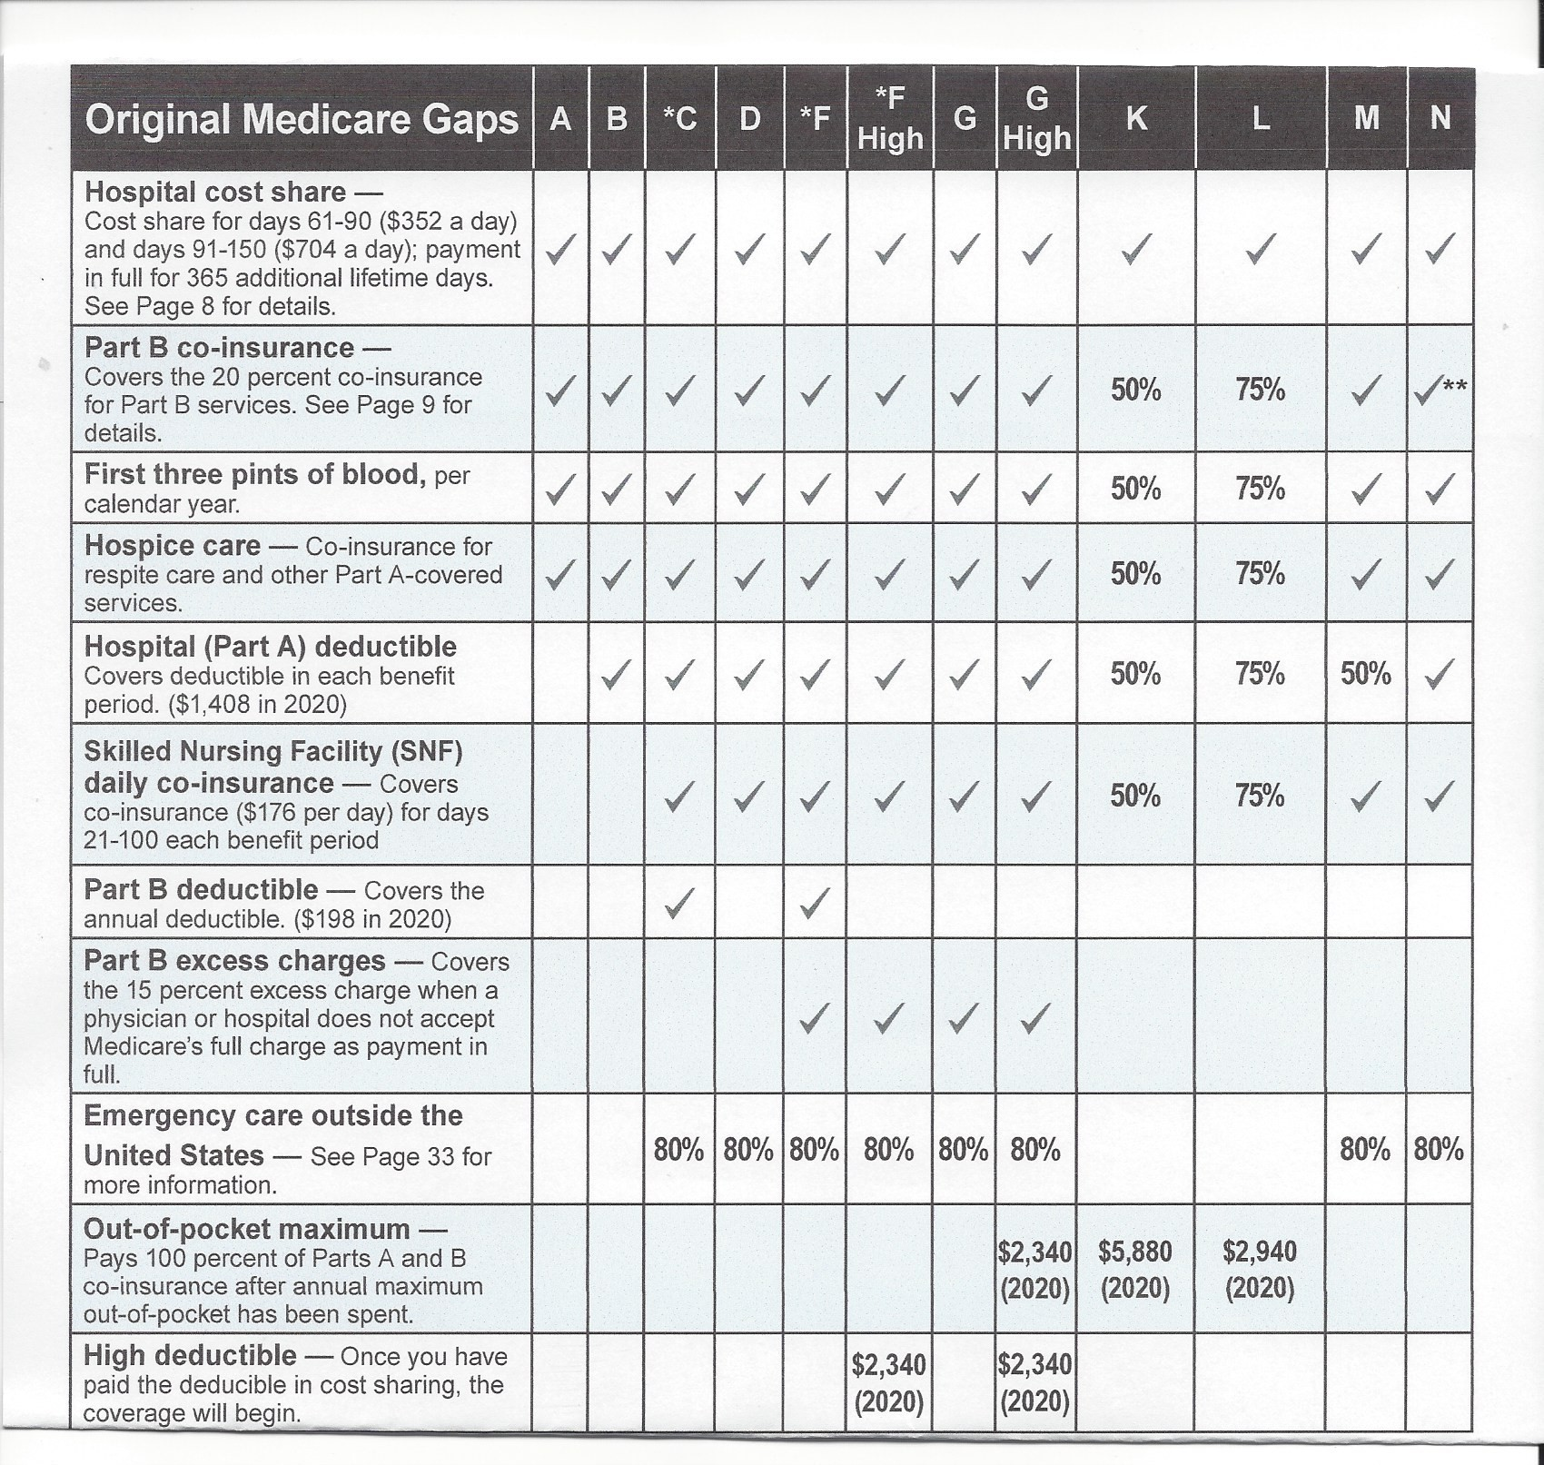

Slide 14
Medigap vs. Advantage
Medigap Plans | Advantage Plans
Higher premiums; increase with age | Usually lower premiums
Plan G: you pay Part B deductible, then no other co-pays for Medicare approved services. Other plans may have other deductibles and/or co-pays | Have co-pays and/or co-insurance. Generally, no deductible except for prescription drugs
Nationwide coverage and wider range of specialists BUT may be harder to find a PCP. Fewer denials and quicker authorizations. Simpler bookkeeping. | Limited doctor networks by geographic area (HMO more restrictive than PPO). More complex bookkeeping.
No drug coverage (except PERS) | Include drug coverage
Annual wellness exam instead of annual physical & 3 hospital nights required before skilled nursing | Generally allow annual physical exam & don’t require 3 hospital nights before skilled nursing
No annual maximum (but generally no costs accrued) | Varying out of pocket maximum per year
No or limited extra benefits

Slide 15

Medicare Plan Finder: Medicare.gov

Slide 16

When to sign up for
Parts A & B
Initial Enrollment Period
  3 months before the month you turn 65 (Coverage begins first day of month you turn 65)
  Month of 65th birthday (Coverage begins first day of month following birthday)
  Up to 3 months after the month you turn 65 (start date is first day of following month)
General Enrollment Period – if you missed initial enrollment times above
  Enroll: January – March of each year
  Coverage begins: First of the following month

Slide 17
How to sign up for Medicare A & B
If you’re currently drawing Social Security:
  you will automatically be enrolled in Medicare Parts A and B and a card will be mailed to you
  If you are eligible to postpone Part B, complete form sent to you and return to Social Security.
If you are not drawing Social Security
  Sign up online at https://www.SSA.gov/benefits/Medicare .
  Scroll to bottom of page to begin application
  Call Social Security 1.800.772.1213 (expect to be on hold; 5-7pm is best time)
  Make an appointment with Social Security in Albany

Slide 18
Questions?
1-541-812-0849
for appointments

Slide 19
What if you are still working?
If you (or spouse) are actively working at age 65 and have an employer group plan that provides ‘creditable’ medical and prescription drug coverage for over 20 employees, you can defer starting Part B and Part D without penalty until you retire.
Recommended for most to start Part A when turning 65 because there is no premium. Postpone part B until retiring to save monthly premium unless employer plan is too expensive
Employer plan is primary; Medicare is secondary
Exception: Recommend to start both Part A and B when turning 65 if fewer than 20 employees or self-employed (Medicare becomes primary, employee plan is secondary)

Slide 20
Adding Part B later
Special Enrollment Period (SEP) when you retire or otherwise lose an employer plan
  You have up to 8 months from loss of group plan to enroll in Part B by completing CMS Form 40-B and get CMS Form L-564 from your employer's HR Dept confirming your EGHP insurance. Firmly establish exact date your Employee Group Health Plan (EGHP) ends. Then mail or take both forms to the Social Security Office in Albany or apply on-line via SSA.Gov (new in 2022.)
  For Medigap or Advantage plan, you have 60 – 63 days to enroll in a plan after loss of group plan (must have part B)
If no SEP, there is a penalty for postponing starting Part B
  Current premium plus 10% for each year delayed, paid for life
COBRA insurance does not count as Part B or Part D exemption

